Slide 1
AngularJS AJAX - $http
The AngularJS $http service makes a request to the server, and returns a response.
The .get method is a shortcut method of the $http service. There are several shortcut methods:
.delete,.get,.head,.patch,.put,.post

Slide 2
Properties
The response from the server is an object with these properties:
.config-the object used to generate the request.
.data-a string, or an object, carrying the response from the server.
.headers-a function to use to get header information.
.status-a number defining the HTTP status.
.statusText-a string defining the HTTP status.

Slide 3
<!DOCTYPE html>
<html>
<script src="https://ajax.googleapis.com/ajax/libs/angularjs/1.6.9/angular.min.js"></script>
<body>
<div ng-app="myApp" ng-controller="myCtrl">
<p>Data : {{content}}</p>
<p>Status : {{statuscode}}</p>
<p>StatusText : {{statustext}}</p>
</div>
<p>The response object has many properties. This example demonstrate the value of the data, status, and statusText properties.</p>

Slide 4
<script>
var app = angular.module('myApp', []);
app.controller('myCtrl', function($scope, $http) {
$http.get("welcome.htm")
.then(function(response) {
$scope.content = response.data;
$scope.statuscode = response.status;
$scope.statustext = response.statusText;
});
});
</script>
</body>
</html>

Slide 5
Angular Modules
AngularJS supports modular approach. Modules are used to separate logic such as services, controllers, application etc. from the code and maintain the code clean. We define modules in separate js files and name them as per the module.js file. In the following example, we are going to create two modules −
Application Module − used to initialize an application with controller(s).
Controller Module − used to define the controller.
Application Module
Here is a file named mainApp.js that contains the following code −
var mainApp = angular.module("mainApp", []);
Here, we declare an application mainApp module using angular.module function and pass an empty array to it. This array generally contains dependent modules.

Slide 6
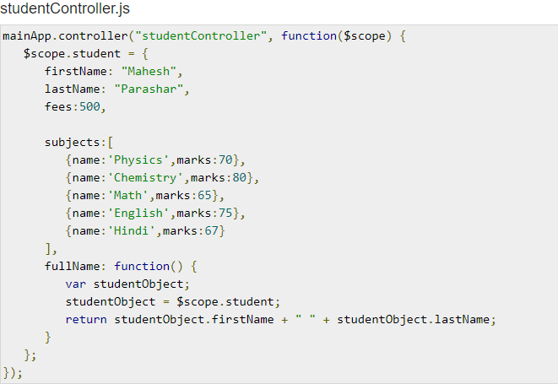
Controller Module:

Slide 7
Deploying Angular App
When you are ready to deploy your Angular application .

Slide 8
Deploy to GitHub Pages
1.Create a GitHub repository for your project.
2.Configure git in your local project by adding a remote that specifies the GitHub repository you created in previous step. GitHub provides these commands when you create the repository so that you can copy and paste them at your command prompt. The commands should be similar to the following, though GitHub fills in your project-specific settings for you:
git remote add origin https://github.com/your-username/your-project-name.git
git branch -M main
git push -u origin main

Slide 9
Continue
3. Create and check out a git branch named gh-pages
git checkout -b gh-pages
4. Build your project using the GitHub project name, with the Angular CLI command ng build and the following options,where your_project_name is the name of the project that you gave the GitHub repository.
ng build --output-path docs --base-href /your_project_name/

Slide 10
Continue
5.When the build is complete, make a copy of docs/index.html and named it as docs/404.html.
6.Commit your changes and push.
7. On the GitHub project page, go to Settings and select the Pages option from the left sidebar to configure the site to publish from the docs folder.
8. Click Save.
9. Click on the GitHub Pages link at the top of the GitHub Pages section to see your deployed application

Slide 11
AngularJS Animations
AngularJS provides animated transitions, with help from CSS.
What is an Animation?
An animation is when the transformation of an HTML element gives you an illusion of motion.

Slide 12
Continue
To make your applications ready for animations, you must include the AngularJS Animate library:
<script src="https://ajax.googleapis.com/ajax/libs/angularjs/1.6.9/angular-animate.js"></script>
Then you must refer to the ngAnimate module in your application:
<body ng-app="ngAnimate">

Slide 13
What Does ngAnimate Do?
ngAnimate notice certain events, like hide or show of an HTML element, the element gets some pre-defined classes which can be used to make animations.
The directives in AngularJS who add/remove classes are:
ng-hide,ng-show,ng-class,ng-view,ng-include,ng-repeat,ng-if,ng-switch
Check the checkbox to hide the DIV in the below example

Slide 14
<!DOCTYPE html>
<html>
<style>
div {
transition: all linear 0.5s;
background-color: lightblue;
height: 100px;
width: 100%;
position: relative;
top: 0;
left: 0;
}
.ng-hide {
height: 0;
width: 0;
background-color: transparent;
top:-200px;
left: 200px;
}
</style>

Slide 15
<script src="https://ajax.googleapis.com/ajax/libs/angularjs/1.6.9/angular.min.js"></script>
<script src="https://ajax.googleapis.com/ajax/libs/angularjs/1.6.9/angular-animate.js"></script>
<body ng-app="ngAnimate">
<h1>Hide the DIV: <input type="checkbox" ng-model="myCheck"></h1>
<div ng-hide="myCheck"></div>
</body>
</html>

Slide 16
What can we test?
E2E
Integration Test
Unit Test

Slide 17
Example - AAA
//Arrange
Michael mic = new Michael();
NGConf ng = new NGConf();
mic.Class = ng;
//Act
mic.Speak();
//Assert
Expect(dw.InterestLevel).toBe(10);

Slide 18
What would you test?
var add = function(num1, num2) { return num1 + num2; };
// test 1
var result1 = add(1,2);
expect(result1).toBe(3);
//test 2
var result2 = add(‘1’,’2’);
expect(result2).toBe(3);

Slide 19
Unit Testing in Angular
Three players:
Process to run the test
Test runner
Assertion library / test framework

Slide 20
Hosting process
There are two options
Real browser
Browser simulator / driver

Slide 21

Test runner
Provide the ability to run the test
Get result (passed / failed with error)
Change configuration
Work with your assertion library
There are many test runners!
We will focus on karma

Slide 22

Assertion library
The syntax you use to write the test
We will use Jasmine
expect(object).toBeArray();
expect(number).toBeOddNumber();
expect(function).toThrowError();
expect(date).toBeBefore(date);
expect(object).toHaveBoolean(memberName);
expect(string).toBeNonEmptyString();

Slide 23

Test environment
Browser
Host code and tests
Browser
Host code and tests
Browser
Host code and tests
Browsers
Host code and tests
Karma
Node JS server
Connects to each browser
Reports the result
Jasmine
Provides test syntax

Slide 24
Karma setup
Install – npm install karma
Setup – karma init file_name
Start – karma start file_name

Slide 25
Karma config file
Frameworks – Jasmine
Files – specific or pattern
autoWatch
Browsers – multiple is supported

Slide 26
Jasmine
Describe – a set of tests
It – a single test
Expect – single expect

Slide 27
Jasmine - matchers
Array
Boolean
Browser
Date
Functions
Errors
Numbers
Objects
Strings

